Slide 1
Concentration Camps
Context for Auschwitz and Terezin

Slide 2
Defining “Concentration Camps”
Camps were an essential part of the Nazis’ systematic oppression and mass murder of Jews, political adversaries, and others considered socially and racially undesirable. There were forced labor camps, extermination camps (death camps), transit camps, and prisoner of war camps.
(From “A Teacher’s Guide to the Holocaust @ fcit.usf.edu)

Slide 3
Major Death Camps
Auschwitz
  Auschwitz-Birkenau
Treblinka
Belzec
Sobibor
Lublin
Chelmno
All were located in Poland.

Slide 4
People in the Camps
Jews
Communists
Socialist Democrats
Jehovah’s Witnesses
“Gypsies”
Dissenting clergy
Gays
Anyone who denounced the Nazi Party

Slide 5
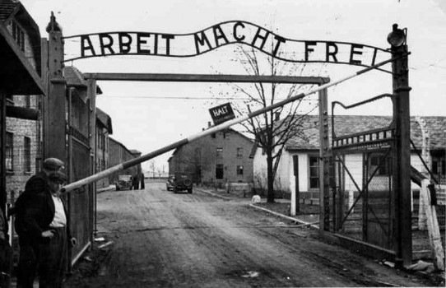
“Work makes you free”: Entrance to Auschwitz

Slide 6
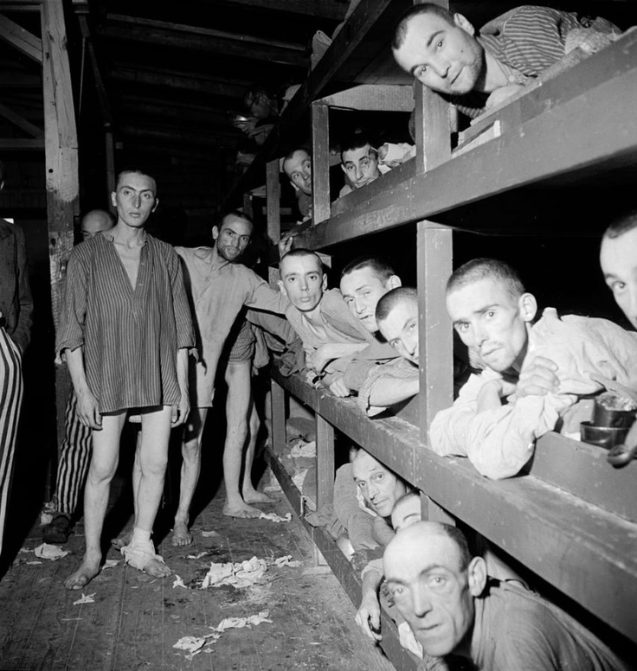
Jewish prisoners at Buchenwald

Slide 7
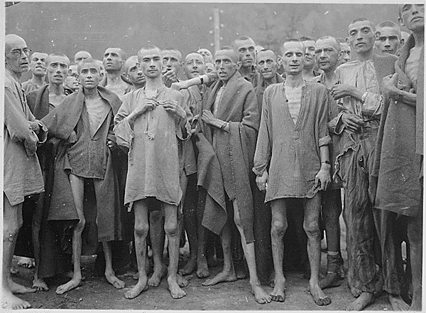
Liberation of Ebensee camp in Austria, 1945

Slide 8
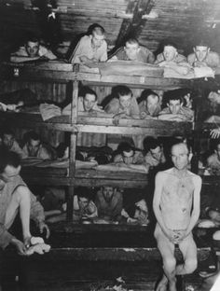
Auschwitz

Slide 9
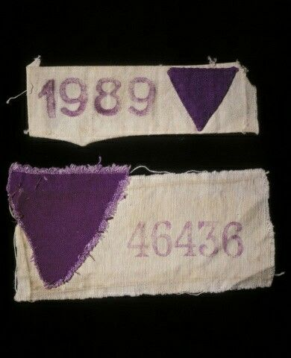
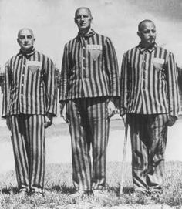
Jehovah’s Witnesses wore the Purple Triangle.

Slide 10
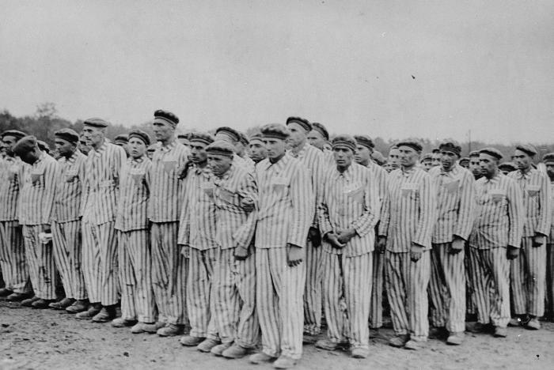
Roll Call at Buchenwald: Gay Prisoners

Slide 11
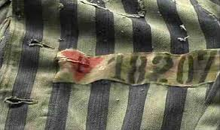
Gay prisoners wore a Pink triangle.

Slide 12
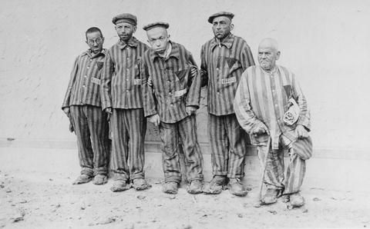
The Black triangle was used for the mentally ill, disabled, prostitutes, and other “undesirables.”

Slide 13
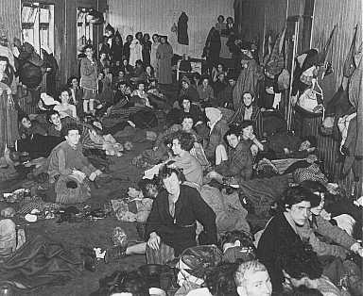
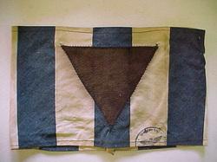
Romani people (called Gypsies). They wore a brown triangle.

Slide 14
Terezin

Slide 15
Terezin
Terezin (or Tereisenstadt) was the “model” concentration camp.
When outside visitors or diplomats came to investigate, the Nazi officials took them to Terezin.
Terezin contained many children.
While many were murdered at Terezin, it was not a full-scale death camp like Birkenau.

Slide 16
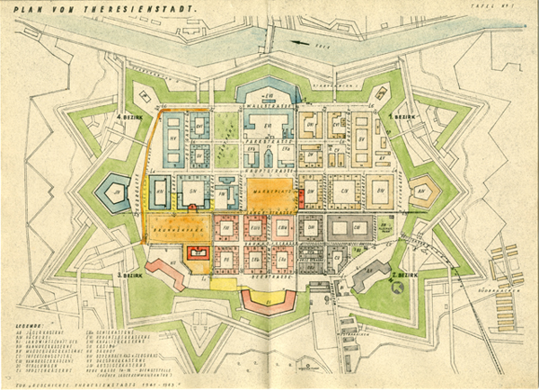
Terezin

Slide 17
Terezin
Built in a fortress in a Czech town, it was used to house thousands of Jews.
Shortly before investigators would come, thousands of prisoners would be shipped to other camps, and the remaining ones would “beautify” the town.
We have surviving artwork and poetry from these beautification programs.

Slide 18
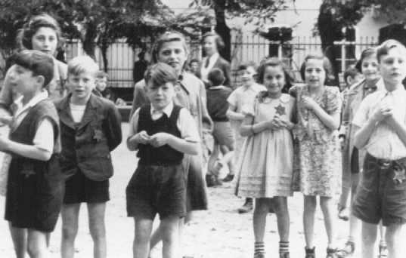
The Red Cross Visit
The Red Cross visited the camp and were fooled by the Germans.

Slide 19
Deaths
Jews:
  Around 6,000,000
POWs
  3,000,000
Romani
  222,000 to 250,000
Handicapped Germans
  70,000
Gays
  12,000
Jehovah Witnesses
  2,500

