Slide 1
WWII & the Holocaust
Historical Context for Night by Elie Wiesel

Slide 2
The Rise of the German Worker’s Party
After World War I, Germany had lost millions of people, its sense of national pride, and was severely punished by the Allied forces.
The German Worker’s party was a right-wing party composed largely of demilitarized soldiers.
The German Worker’s party believed that the left-wing politics of pre-war Germany had “stabbed the people in the back.”
The party believed in national pride, militarism, commitment to the German people, and a “racially pure” Germany.
In 1919, an obscure Corporal named Adolf Hitler rose to leadership in the party and changed the name to the National Socialist German Worker’s Party, or the Nazi party.
Notes:
The Treaty of Versailles forced Germany to disarm and to pay reparations to France and Britain for the huge costs of the war.
While the Nazi party called themselves socialists, they were far from it.
At the end of 1920, there were about 3,000 Nazi party members, and Hitler was their leader, or Fuhrer.

Slide 3
Gaining Support
The Nazi party attempted to overthrow local government if Munich, Germany. However, it failed and they were all jailed.
While in court, Hitler used his charisma to rant for hours about the the government and his anti-semitic views. He actually gained supporters. He was released from prison a year later.
In 1925, President Paul von Hindenburg was elected. The same year, Hitler was declared the sole leader of the Nazi Party.
Notes:
Nazi party members had to swear loyalty unto death to Hitler. All decision making power rested with him.
In 1929, the Nazi party had grown to well over 100,000 members.

Slide 4
Government Control
In 1929, the Great Depression had affected the German economy. While arguing about politics and a budget, the official government collapsed.
President Hindenburg invoked a type of government that overruled the Riechstag (normal government control, think the Constitution). He appointed a chancellor and cabinet members.
In 1932, President Hindenburg won re-election, but Hitler ran as his opponent and won almost 40% of the votes.
In subsequent elections, Nazi party members controlled about 37% of the government seats.

Slide 5
Chancellorship
In 1933, Hitler was appointed to the position of chancellor.
A fire occurred in the Riechstag building. Hitler used this to persuade President von Hindenburg to decree “The Protection of the People and State” which allowed the Nazi’s an incredible amount of power in dealing with “emergencies,” and laid the foundation for a Police state.
Within months, Dachau was constructed.
The Enabling Act was passed.
Notes:
It is widely speculated that the Nazi’s themselves set the fire.
Dachau was the first concentration camp, and socialist, communist, and labor leaders were arrested and sent there.
Dachau became the training grounds for guards of the other camps, and they were taught tactics to dehumanize prisoners.
The Enabling Act allowed the government to issue laws without the Riechstag. Parliamentary government ended.

Slide 6
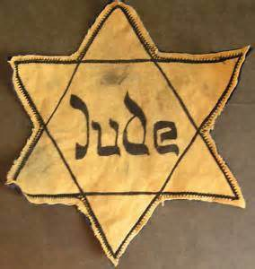
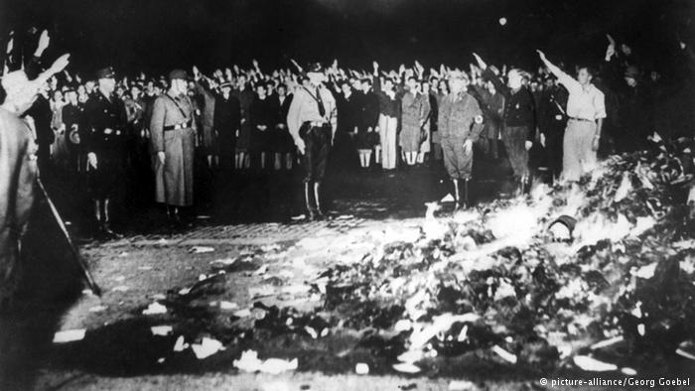
Civil Actions Against Jews
1933:
  Jews were barred from holding public offices, civil services, medical and legal professions, and education careers.
  Book burnings of Jewish texts were sanctioned, as was the boycott of Jewish businesses.
  Anti-semitic propaganda started to be released.
  The Hitler Youth program took off.

Slide 7
The Military and the SA
The SA was a military force that helped Hitler rise to power. There were about 2.5 million of them in 1934, compared to about 100,000 German military members.
Hitler feared the military would force him from office, so in a show of support, he attacked the SA and arrested many leaders on “The Night of the Long Knives.”
They were shot by the SS, which was Hitler’s private military force.
Notes:
Under Himmler, the SS became the most powerful affiliated Nazi group. They controlled the police, security, concentration camps, and terror.

Slide 8
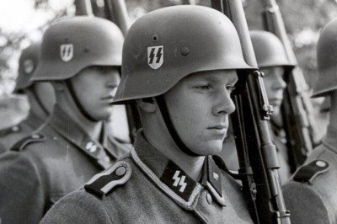
SS Troops

Slide 9
In 1934, President Hindenburg died. Hitler declared himself Leader of the Reich.

Slide 10
1935: The Nuremburg Laws
Stripped Jews of civil rights.
  Jews were no longer German citizens.
  Jews were declared as a separate race.
  Jews were not allowed to marry or have sexual relations with Germans or non-Jews.
Hitler warned that if these laws were not followed, he would turn to a “final solution.”

Slide 11
1938: Lebensraum
The Nazi party wanted more land for its growing population and furtherment of the “aryan race.”
Germany annexed Austria with no bloodshed. The overwhelming approval of the Austrian people helped this, and although this violated the Treaty of Versailles, no one said anything.

Slide 12
Sudentenland
3 million German speaking people lived in Czechoslovakia, which Hitler called the Sudentenland. He wanted control.
Hitler met with British Prime Minister Chamberlain and threatened war if he did not receive the territory.
Rather than go to war, the Western powers chose to allow Germany to occupy Czechoslovakia.

Slide 13
1938: Kristallnacht
“The Night of Broken Glass”
  Led by Propoganda Minister Joseph Goebbels
  Free for all against Jews.
1,000 synagogues set on fire. 76 were completely destroyed.
Over 7,000 Jewish businesses were destroyed.
100 Jews were killed, and 30,000 were arrested and sent to Dachau.
(put the paper about caring for German ppl here)

Slide 14
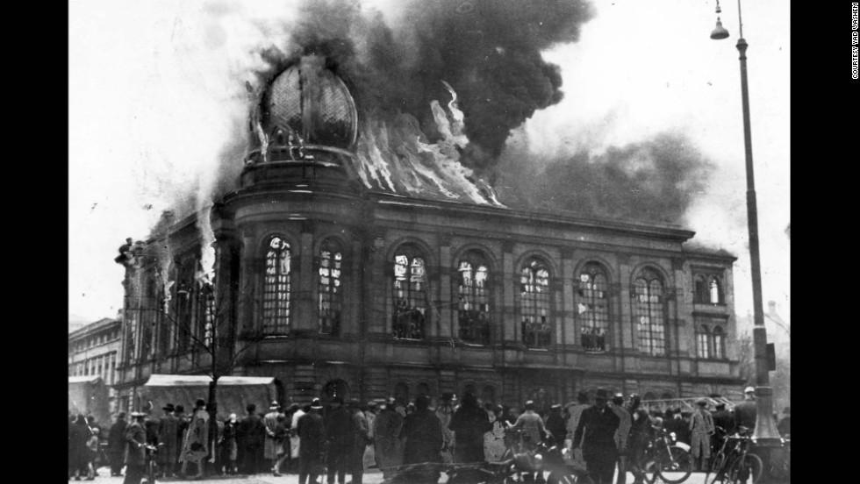
Boemestrasse Synagogue in Frankfurt

Slide 15
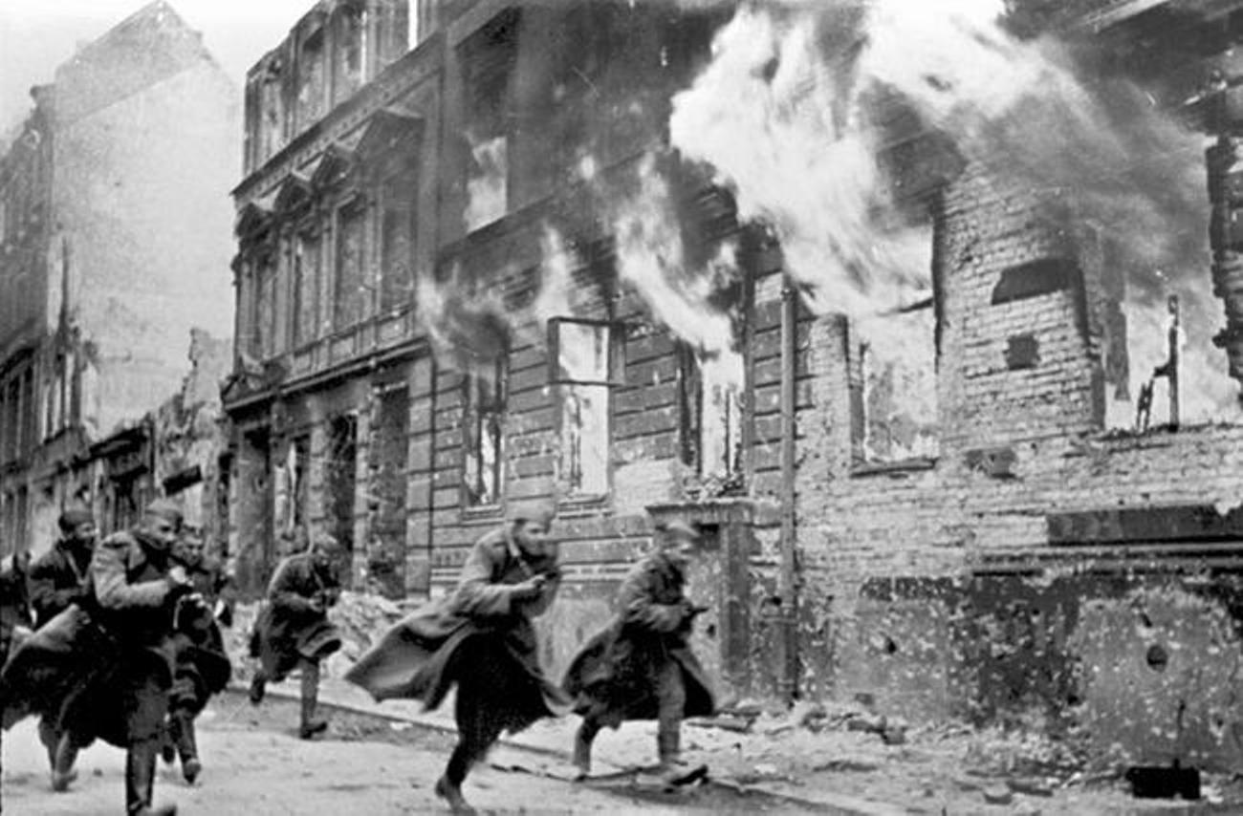

Slide 16
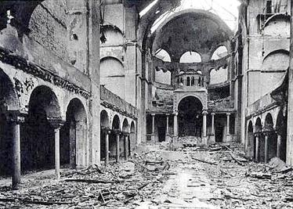
Fasanenstrasse Synagogue in Berlin

Slide 17
Effects of Kristallnacht
Within days of Kristallnacht, Jews were barred from public school.
All Jewish businesses and assets were to be transferred to Aryan control.
Jews were forced to pay for the damages.

Slide 18
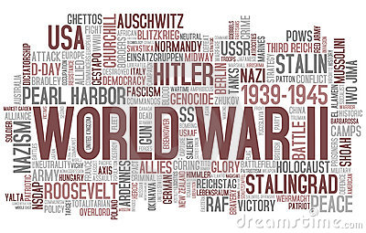
1939: War
On September 1, 1939, Germany invaded Poland.
World War II had begun.

